Slide 1




SMART
ECO
SmartEco
Automated trash can
Islamjan Torejanov

Slide 2
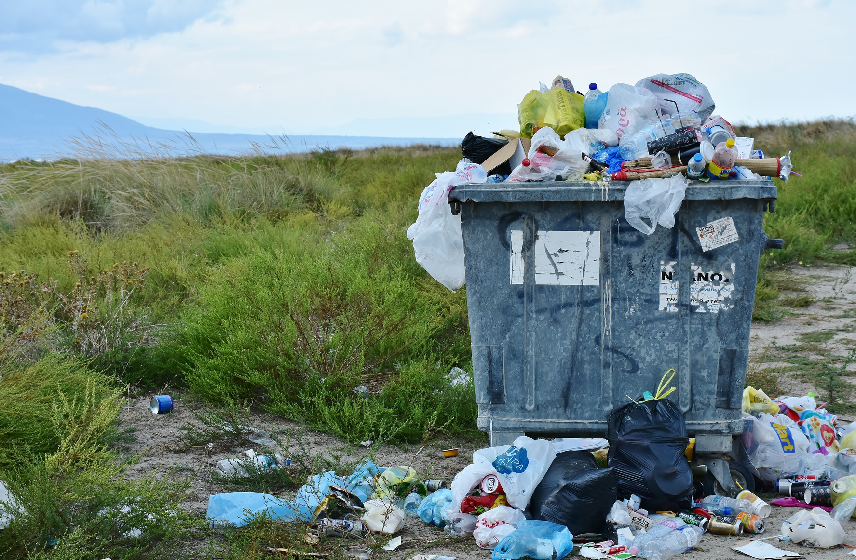


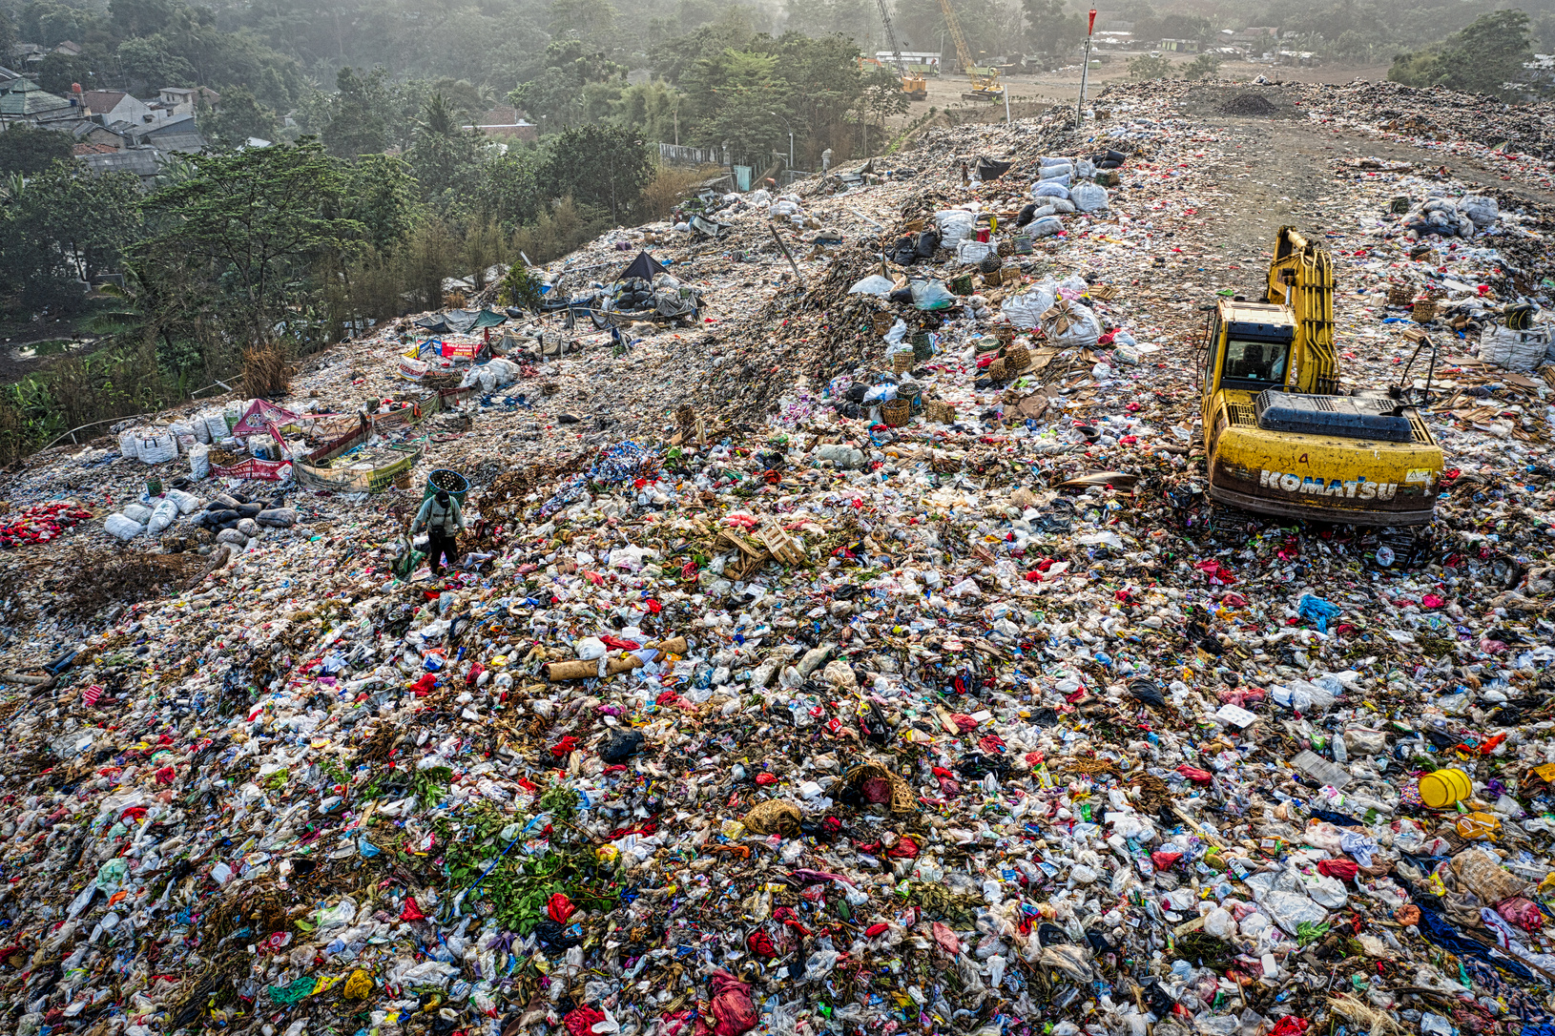

Problem
Non-regulation (sorting) of waste
SMART
ECO
The uniformity of garbage cans in many places
Due to the uniformity of garbage cans, waste is not separated when it is thrown, and it becomes difficult to organize them.
Low awareness of local population about waste recycling
Due to the slow thinking of household waste recycling, we can see different types of garbage in our cities and streets.
As a result;
Landfills are overflowing
Due to the lack of regulation of waste, recycling becomes difficult. As a result, garbage falls into the landfill and fills the garbage volume
Ecological changes
Pollution of earth and earth's resources due to garbage means gradual pollution of living. Various odors, drinking water, wildlife and food contamination.

Slide 3
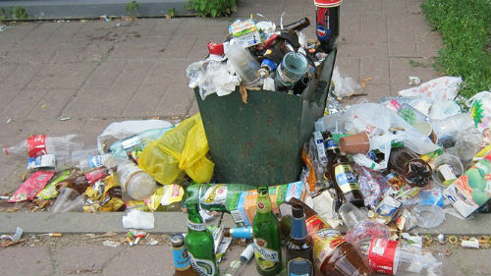
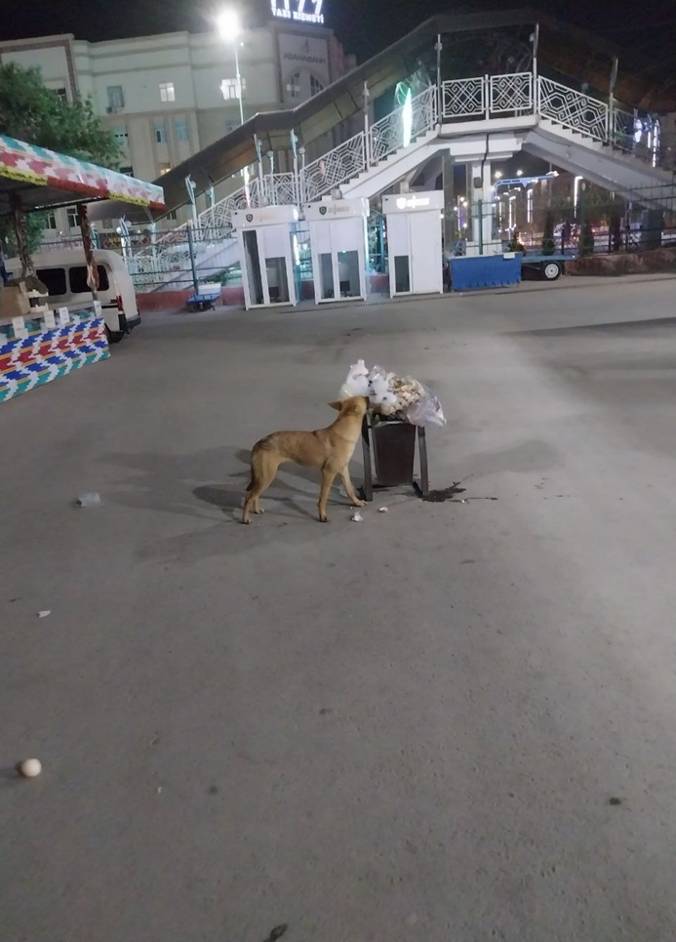
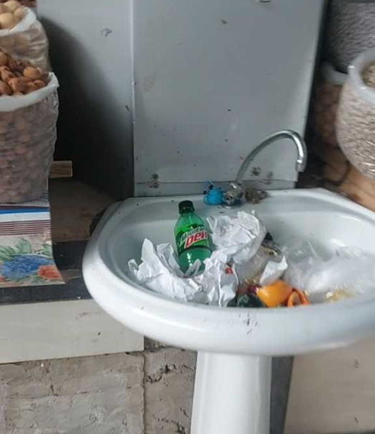
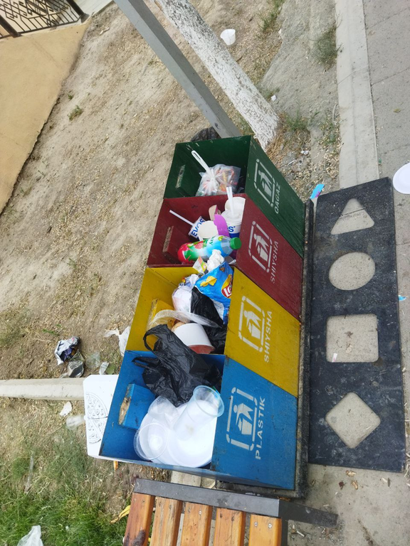
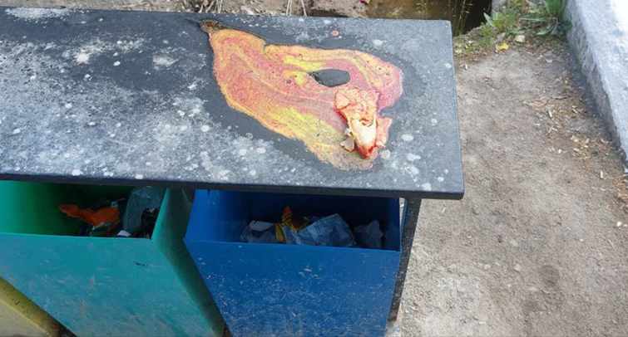
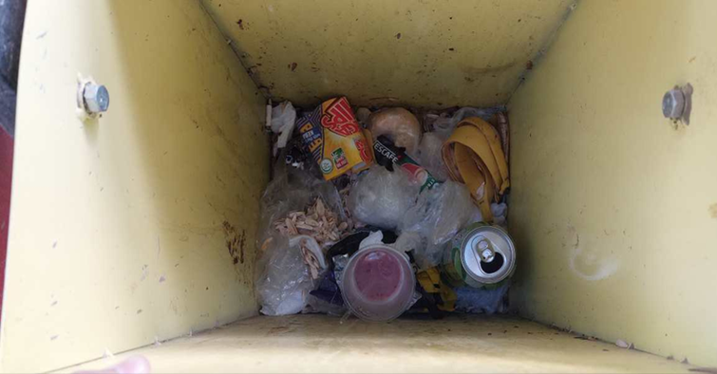
Clips from the issue:
SMART
ECO

Slide 4
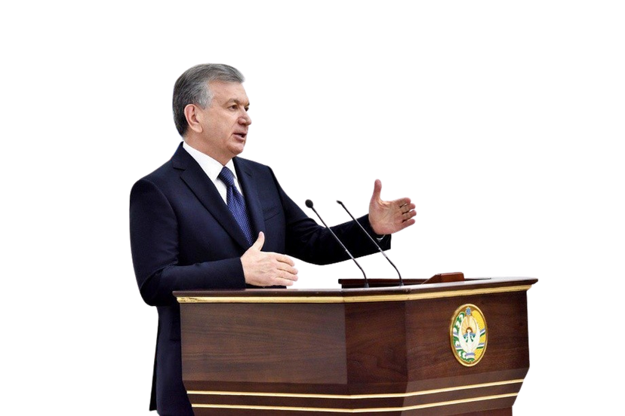
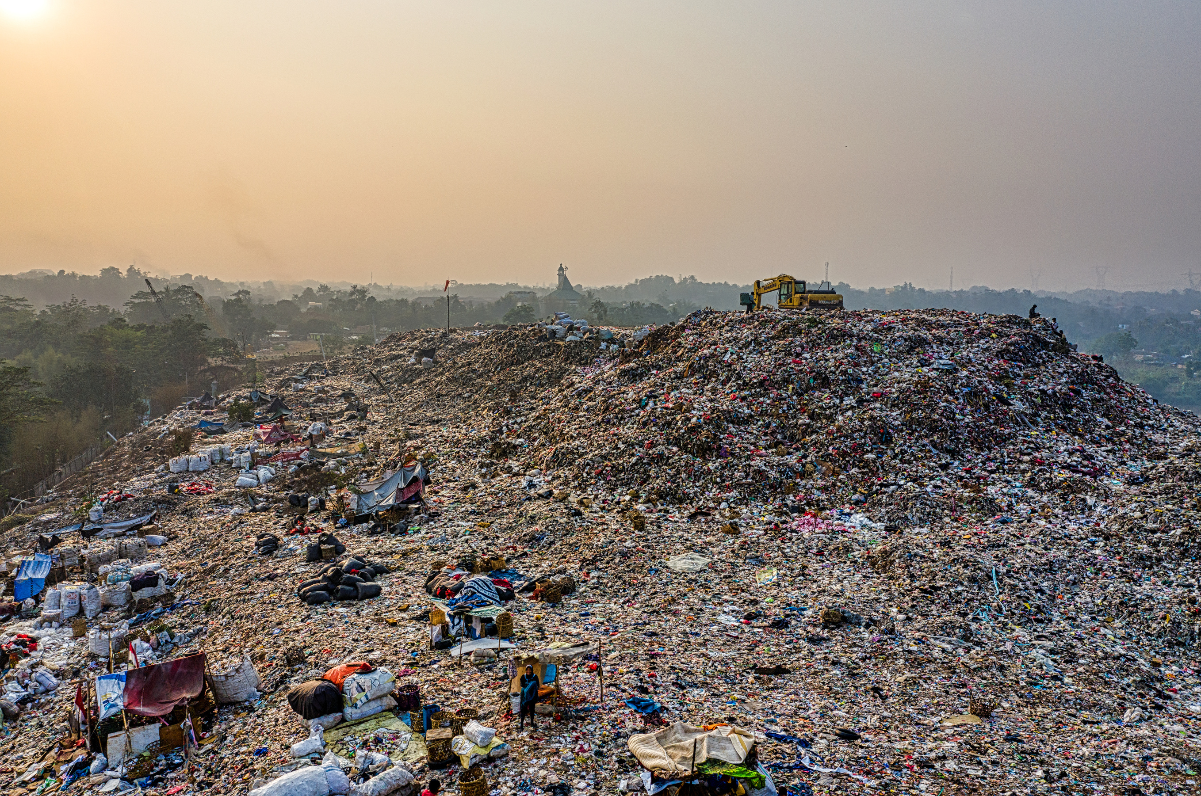
... The most important issue is monitoring the ecological culture of the population. Look on the street or nearby today. You see people leaving everywhere. We call our motherland sacred. Why don't we keep it clean? After all, it is said in our holy books that "Purity comes from faith"...
SMART
ECO
Sh.Mirziyoyev
\ According to the analysis, an increase of 1 percent annually per capita at the strict household level in all countries. Due to the economic and social growth in our country, this indicator has reached 7 million tons and is growing by 2% per year.
However, the condition of their collection, sorting, processing and disposal is not satisfactory. For example, only 10% of waste is processed in Karakalpakstan, 20% in Fergana and Kashkadarya. The issue of bringing out the problems in 781 neighborhoods has not been resolved. The population has a lot of food receivables in this area. There are 19,000 waste containers for medical and educational needs, markets. (https://kun.uz/)

Slide 5
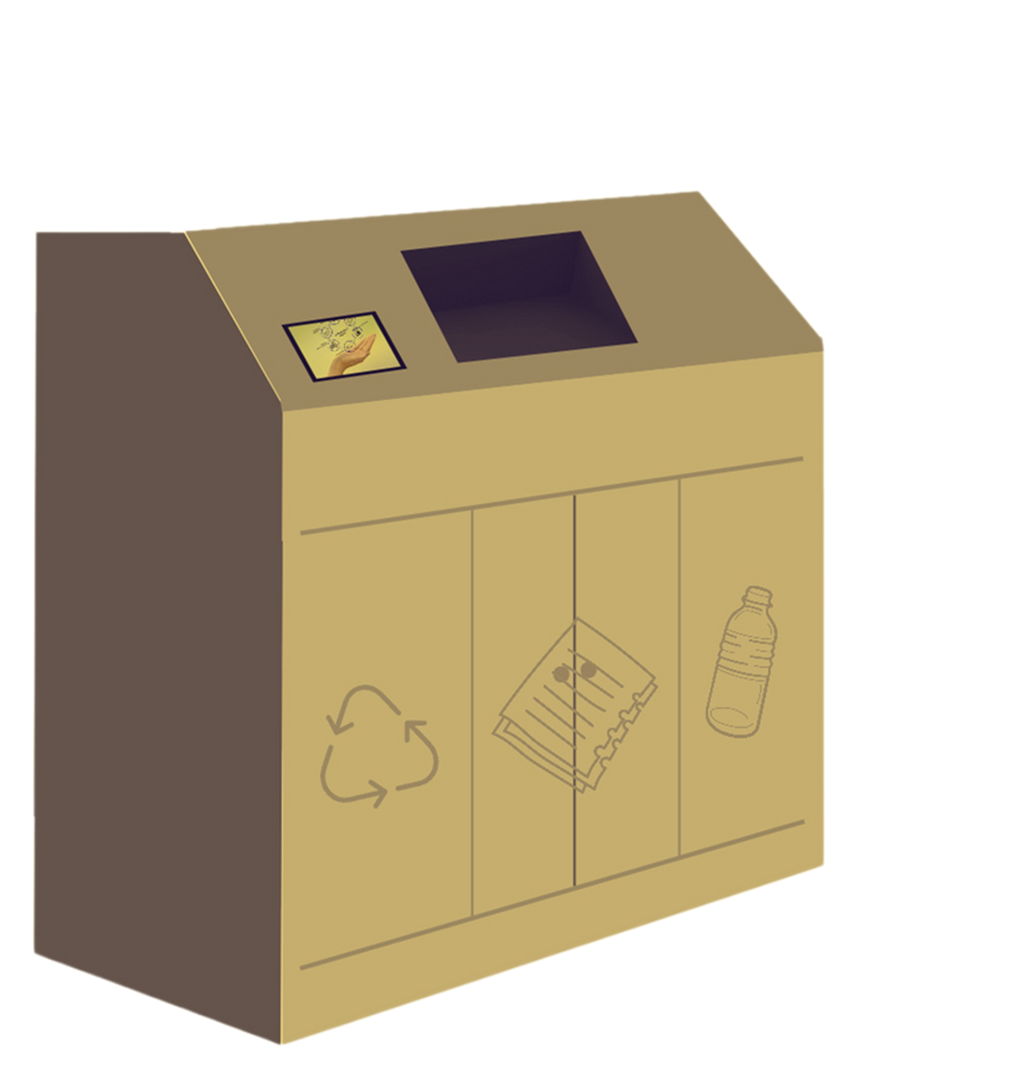
The solution
SMART
ECO
SmartEco
SMART
ECO
SmartEco is an AI-based smart waste bin designed for public spaces to simplify recycling. It automatically sorts the waste, monitors the filling level and classifies it according to the type of waste and directs it to the appropriate bin. All this with 92% accuracy

Slide 6

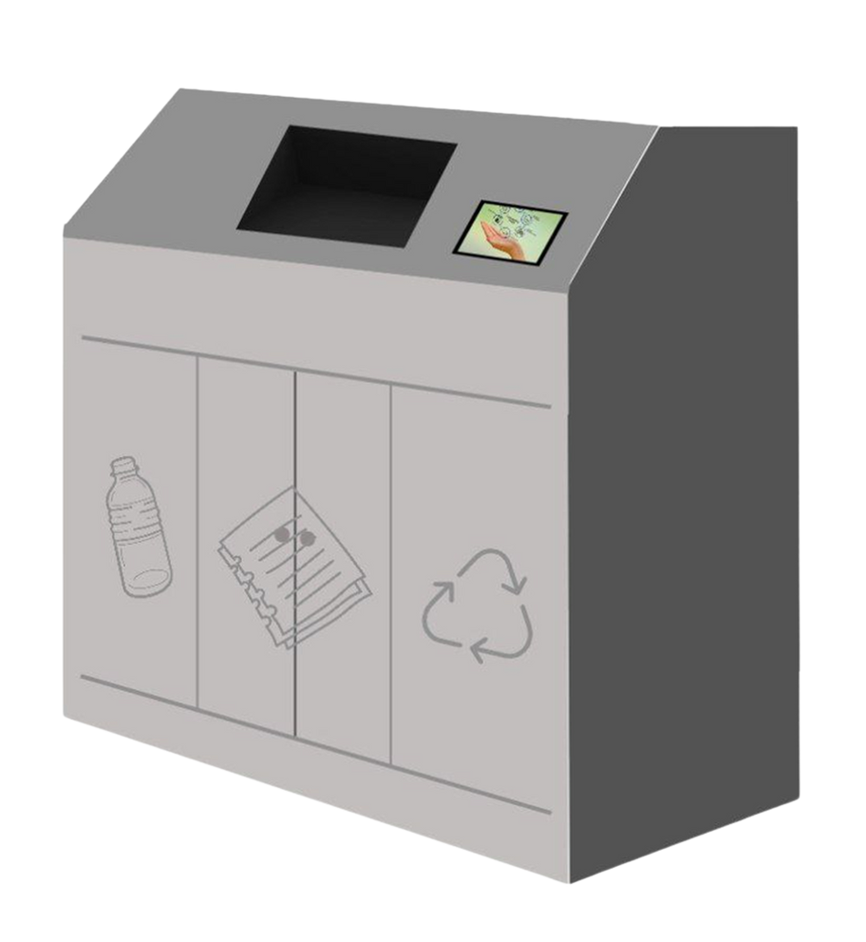

waste receiving place
SMART
ECO
waste bin analysis
1.15 m
place of garbage cans
SmartEco automated waste bin sizes and specifications may change according to requirements (customer, customer...)
1.28 m
0.45 m

Slide 7
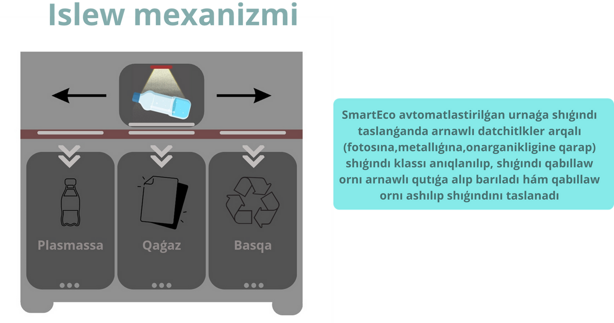

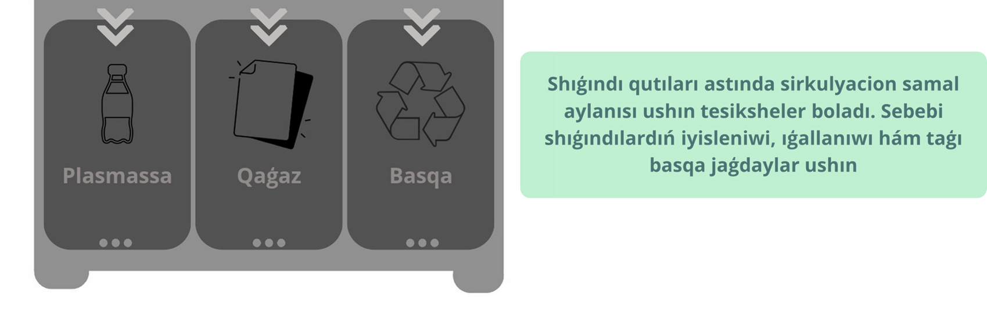
When you throw waste into the SmartEco automated trash can, it is separated into groups by special sensors, the waste receiving relay takes it to the appropriate bin, and the bottom opens and puts it in the trash can.
In place of garbage cans, there are special holes for the circulation of wind. It eliminates odors, moisture and other conditions of waste.

Slide 8
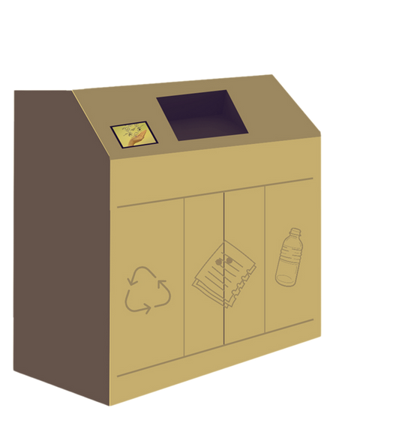
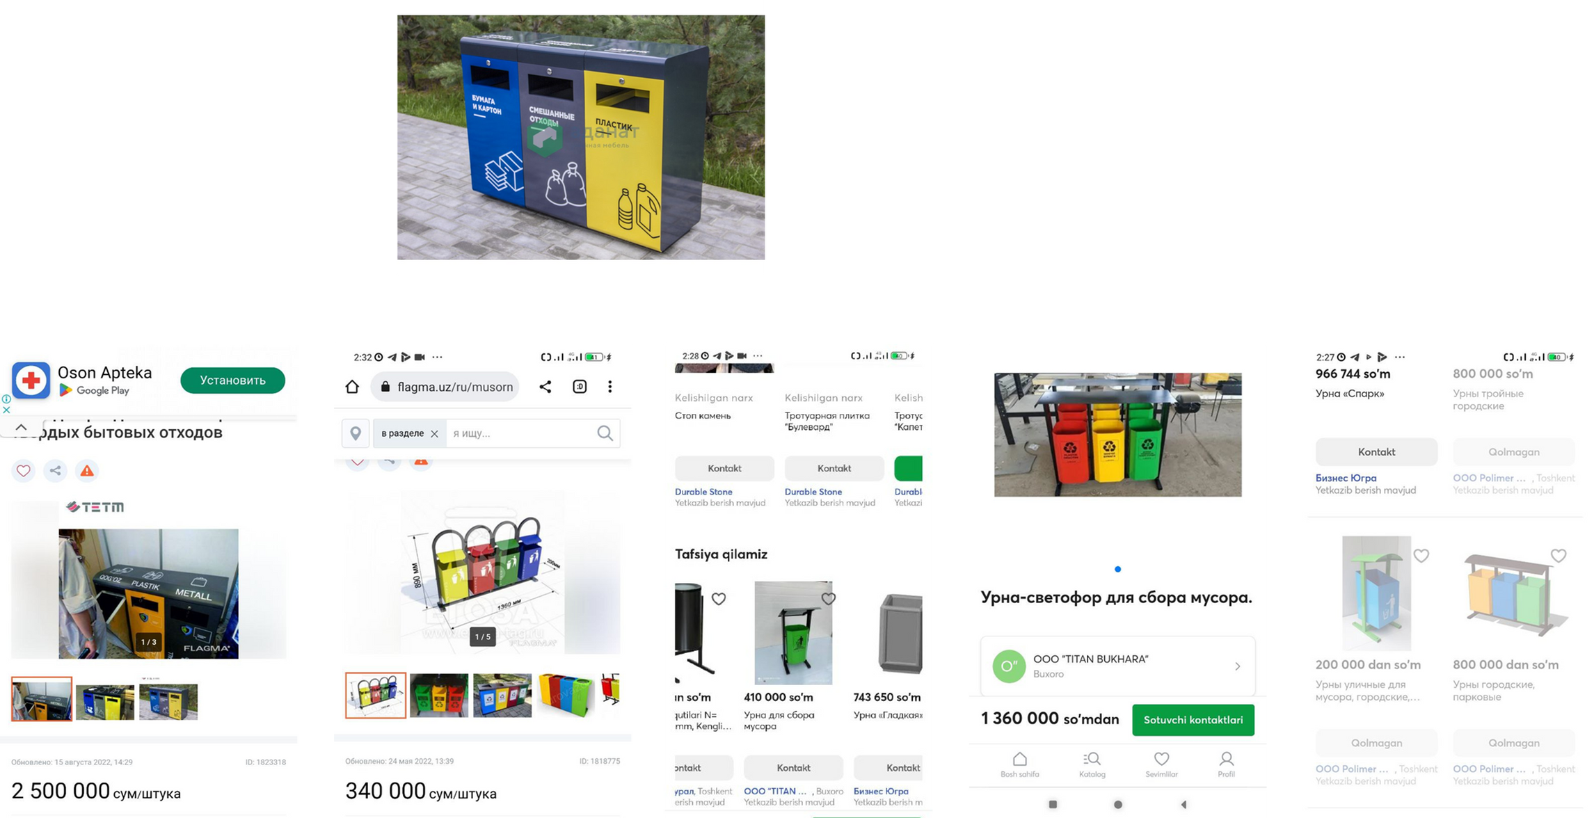

Slide 9
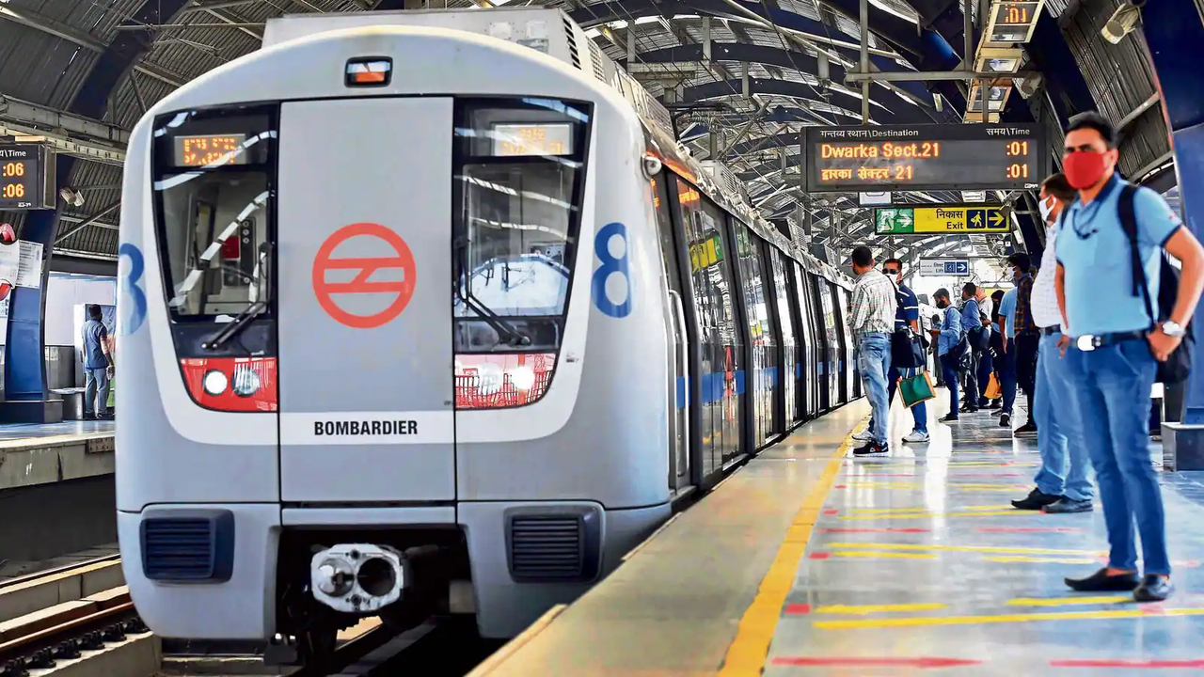
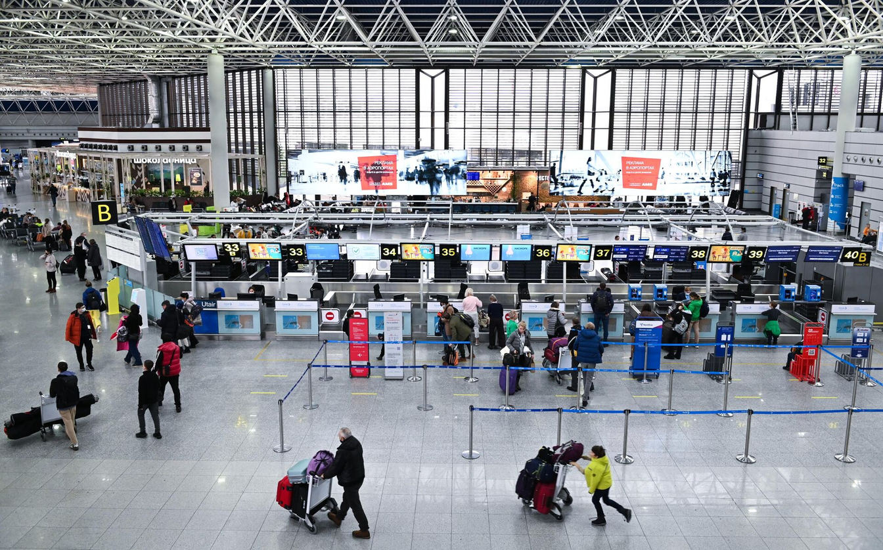
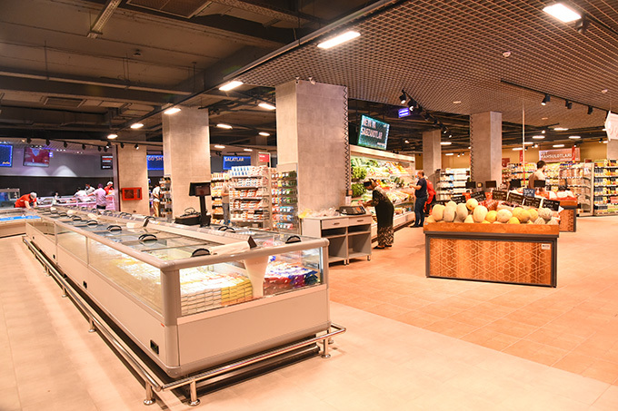
SMART
ECO
In addition, waste processing can create significant opportunities for their management
Location
This automated garbage can is one of the optimal options suitable for densely populated areas

Slide 10



Project forecast
SMART
ECO
50
Production
If an automated garbage can contains 4 million soums on average, 3 units are produced in 1 month. If the number of interested people increases, we will increase the production balance
40
30
Benefit
Compared to other trash cans, the prices are analyzed, and they are sold at 15% more than the cost price. (Installation, warranty and others)
20
10
Waste processing
0
Innovation and practical work aimed at waste processing and management will be launched
2024
2025
2026
2027
2028

Slide 11
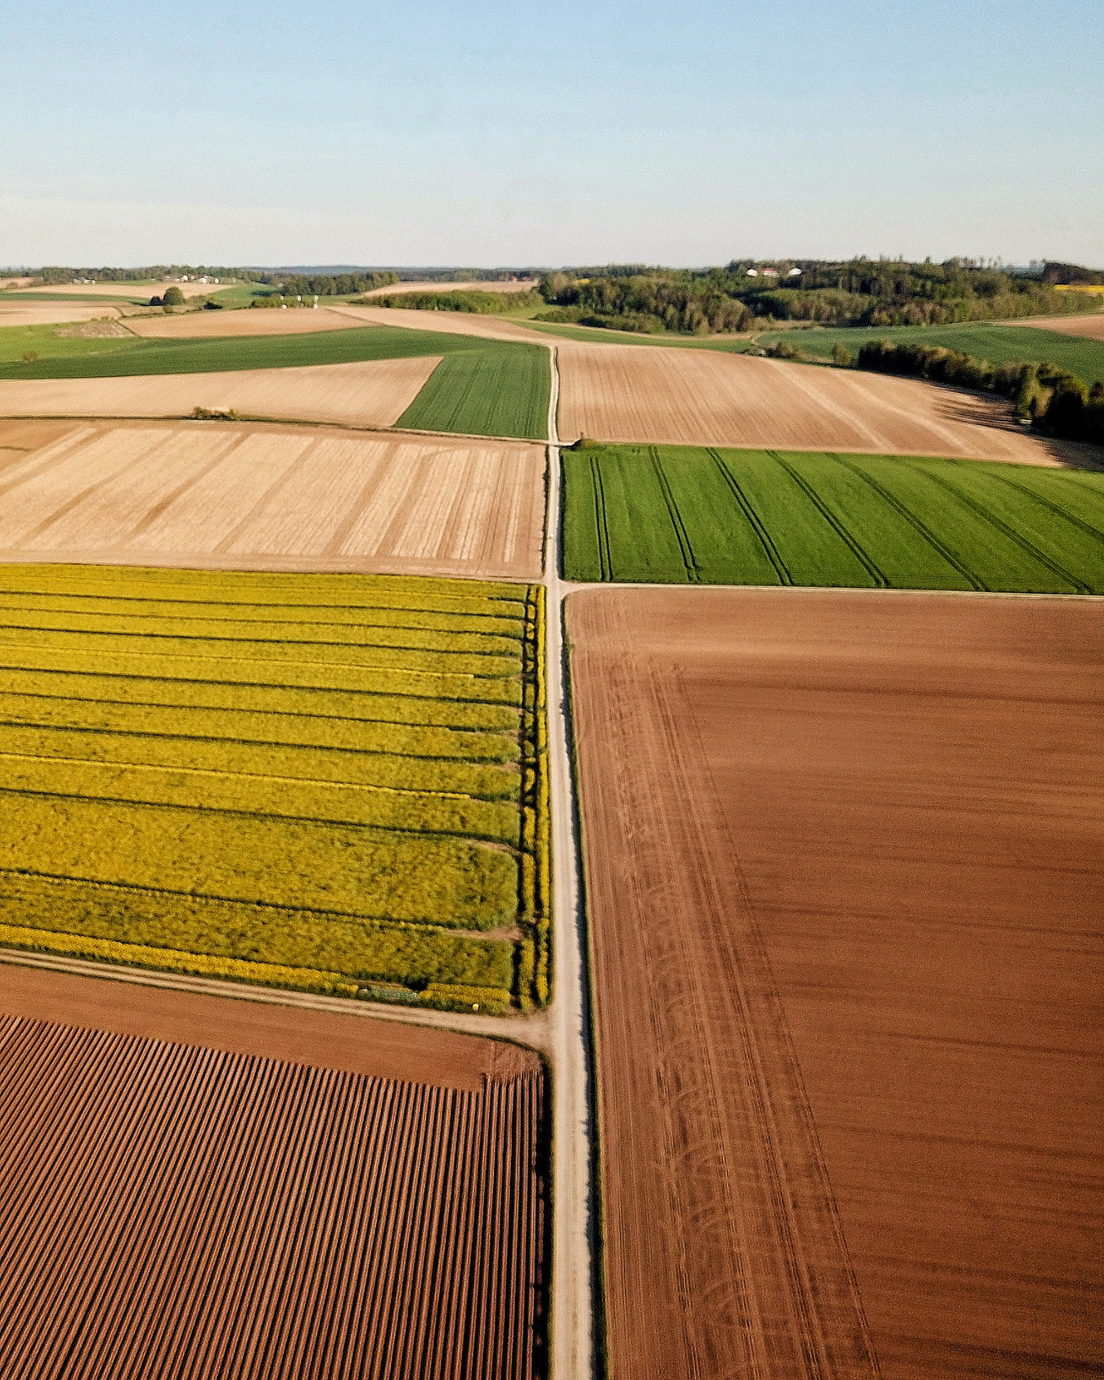
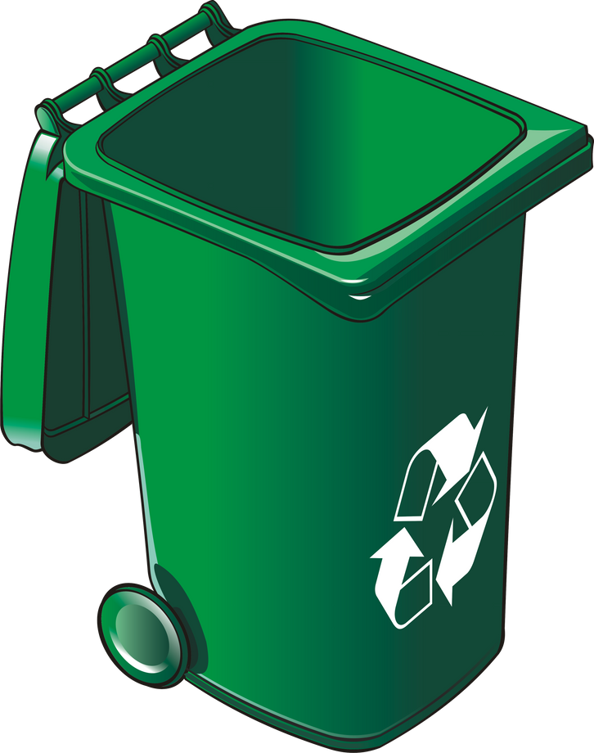


SMART
ECO
In the future, it is necessary to establish the economics of waste processing and take measures to expand it. This is the main purpose of SmartEco. To achieve this goal, SmartEco's automated litter box performs the role of transport

Slide 12

SMART
ECO
THANK YOU!

